Slide 1
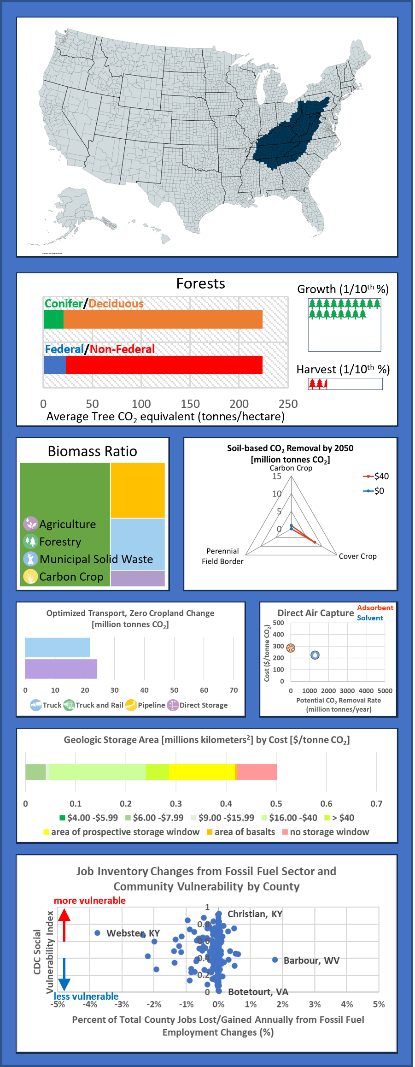
Call-Out Key
Forests:
Average aboveground tree carbon density divided between conifer and deciduous varieties, and that are located on federal or non-federal land for management. Growth: chart shows the percentage of annual aboveground growth including mortality, excluding harvest. Harvest: percentage of forests harvested annually on all land. Green indicates net growth, red indicates net mortality/harvest. Each tree icon represents 1/10th of a percent, each line of trees represents 1%.
Highlighted Region Map:
Depicts the counties included within the region described.
Biomass Ratio:
Percentage of annual biomass produced assuming a 2050 scenario with zero cropland change.
Cropland Soils:
Cumulative soil-based CO₂ removal potential by 2050 assuming modified cropland practices priced at $0 and $40/tonne CO₂.
Carbon Transportation:
Biomass and CO₂ transportation volumes and direct storage from BiCRS facility without transportation in 2050 assuming an optimized cost with zero cropland change.
Direct Air Capture:
Weighted average costs and potential removal rate of CO₂ from the air by 2050, assuming amine-based solid adsorbents or liquid solvent, powered by renewable electricity.
Geologic Carbon Storage:
Topographic area for conventional geologic CO₂ storage in binned at projected costs per tonne. Areas of prospective storage and of basalt require further study, and no storage window indicates land void of reasonable storage potential. The sum of the area approximates the total size of each region.
Jobs and Social Vulnerability:
2015-2021 average job changes from the fossil fuel sector vs. the Social Vulnerability Index reported by the CDC—1 is more vulnerable, 0 is less vulnerable. Each point represents a specific county in the region; about 50% of the counties are not reported due to lack of available data on one or both indices.

